Slide 1
AWS Cloud Computing Project (Vprofile AWS Lift & Shift Application Workload Project)
Prepared & Documented by Abdullahi Wisdom Saliu
Source Code: https://github.com/Saliu40/currentJob-vprofile-project.git
Switch Branch to awsLift&Shift

Slide 2
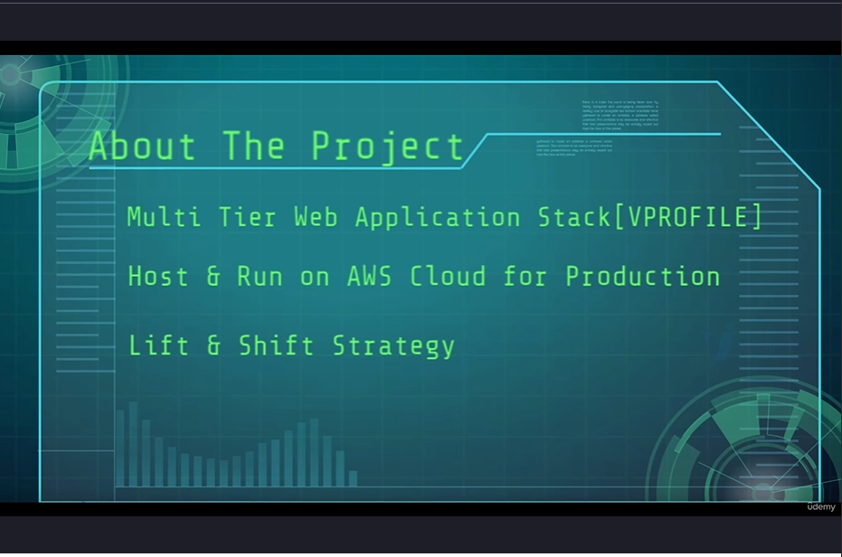
About The Project

Slide 3
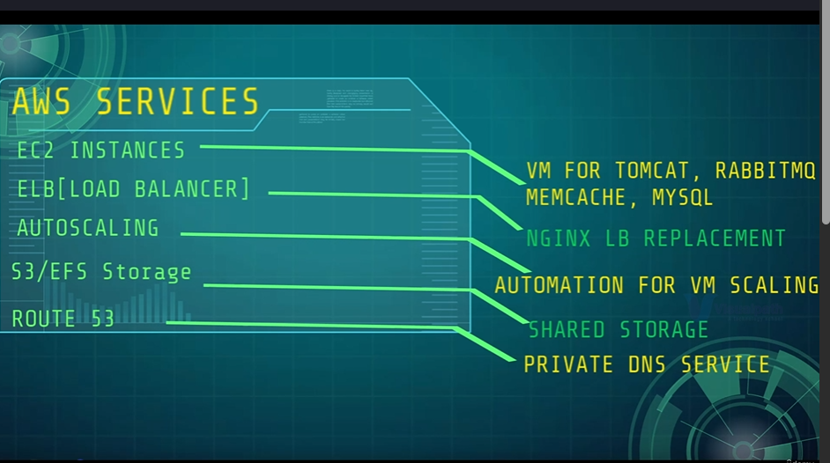
This is going to be a cloud Based Project(Running on AWS)

Slide 4
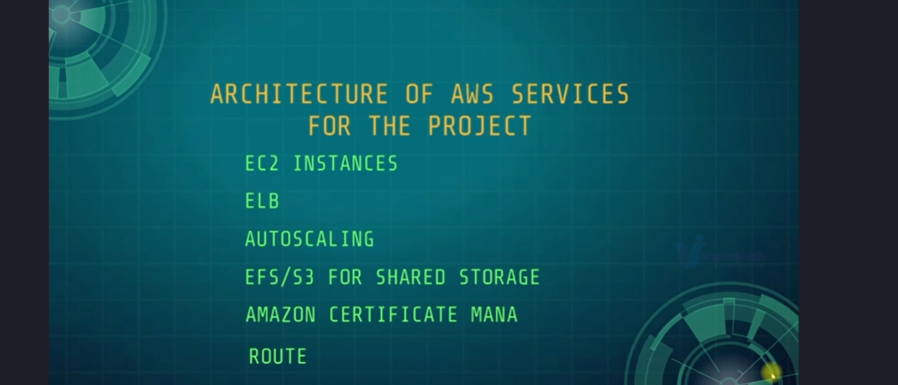
AWS Architectures we will be Creating

Slide 5
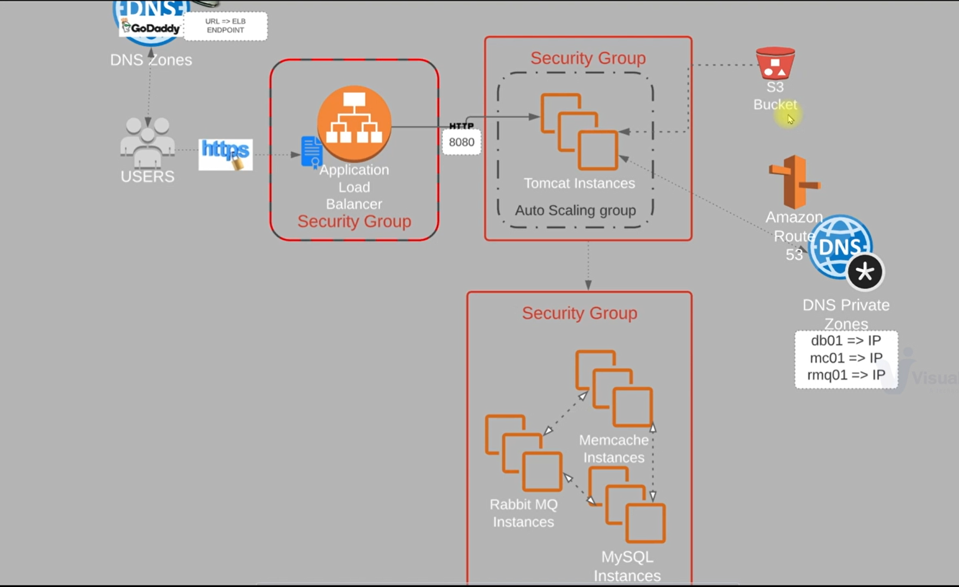
Architecture Diagram

Slide 6
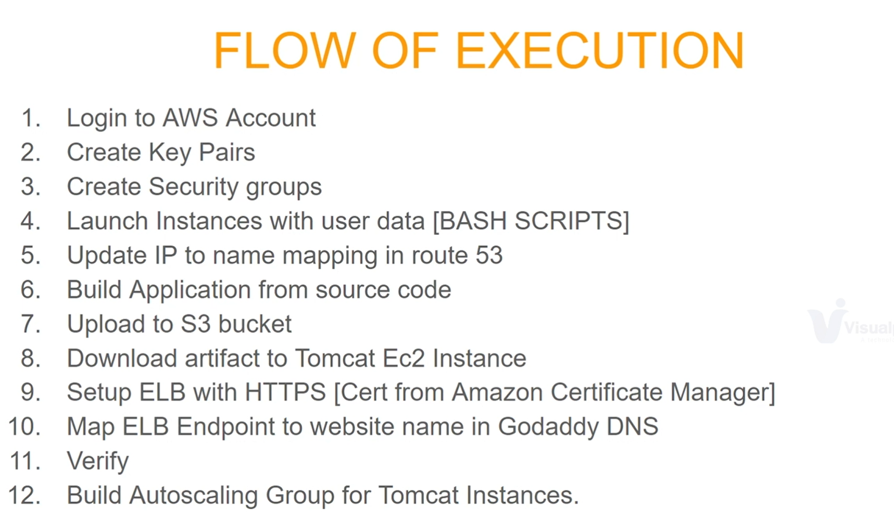
Flow of Execution

Slide 7
Creating AWS Account & Key Pairs Gen
Go to AWS registration portal and Create a free tier account
Fill out the necessary Information,
Insert your Credit/Debit card details, and create Your Account.
After creating the AWS Account, Login, & clicked on ec2, scroll down to 'key pairs' generate a .pem key pairs and download Ur private keys. Alternatively you can just generate ssh-keys on Ur local VM, copy the publickeys and upload it to the AWS key pairs and save it.

Slide 8
Creating Security Group for my Services
we are creating a total of 3 security groups:
1. For the Elastic Application Load Balancer, the rule will be http, & Https with default port 443.
2. Application (Tomcat), rule will be port 8080 allowed from the LoadBalancer Security Group,
Also allow port 22 for ssh. At the end it will also connect with the backend services such as mysql, memcached, & rabbitMQ.
3. the Backend services SG such as the Mysql, Memcached, and the RabbitMQ.

Slide 9
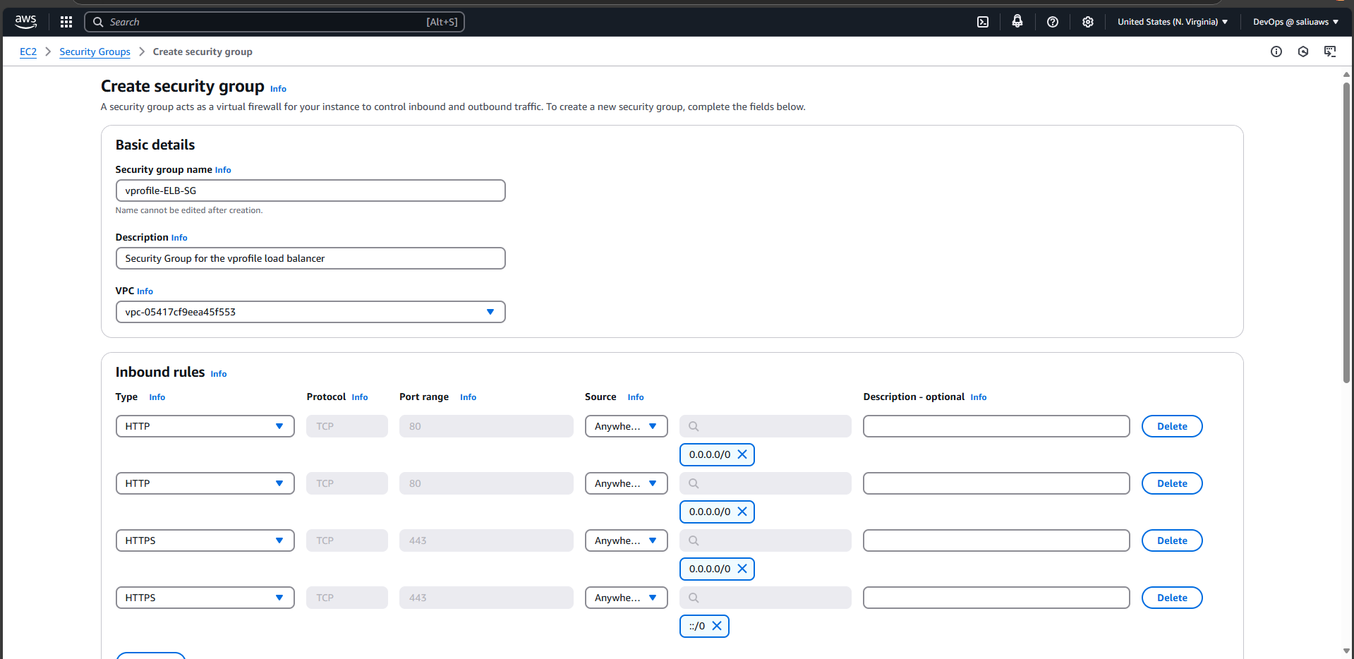
Elastic Load Balancer Security Group
Edit inbound rules:
1. add two http, allow from any ipv4, & any ipv6 2. add two https, allowed from any ipv4, & ipv6 respectively.
Note: we added https because we are going to assign a domain certificate that we earlier puchased from goDaddy website.

Slide 10
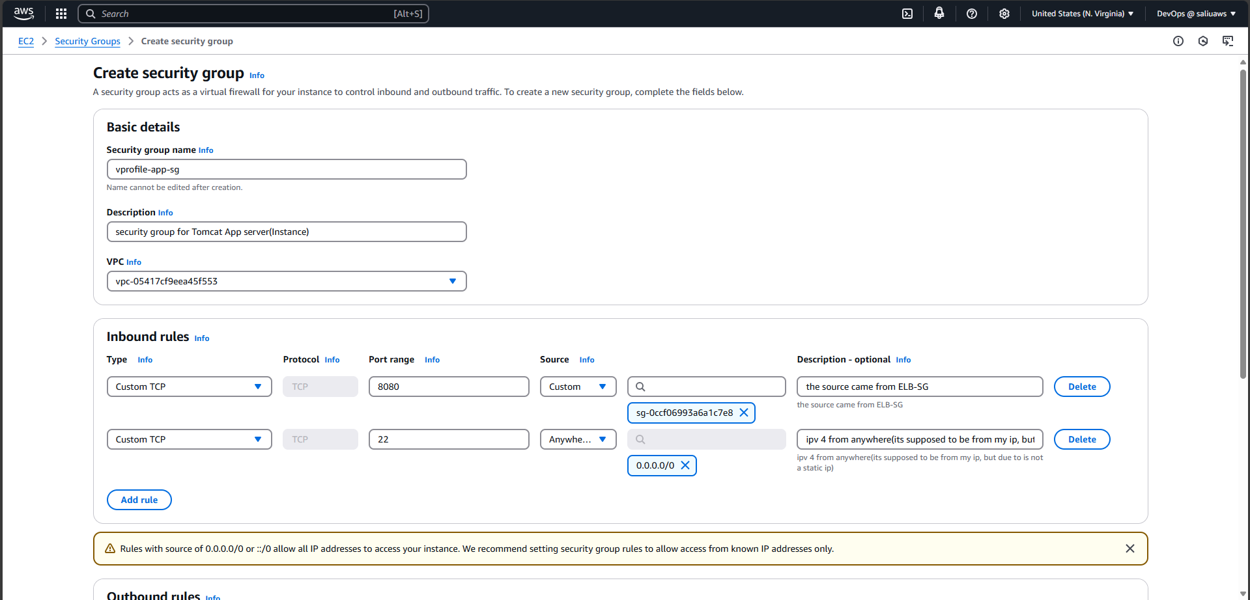
Security Group For The Application (Tomcat Instance)
Edit inbound rules:
1. add port 8080, source: select the ELB Security Group. 2. add port 22, source: select ipv4 from anywhere.

Slide 11
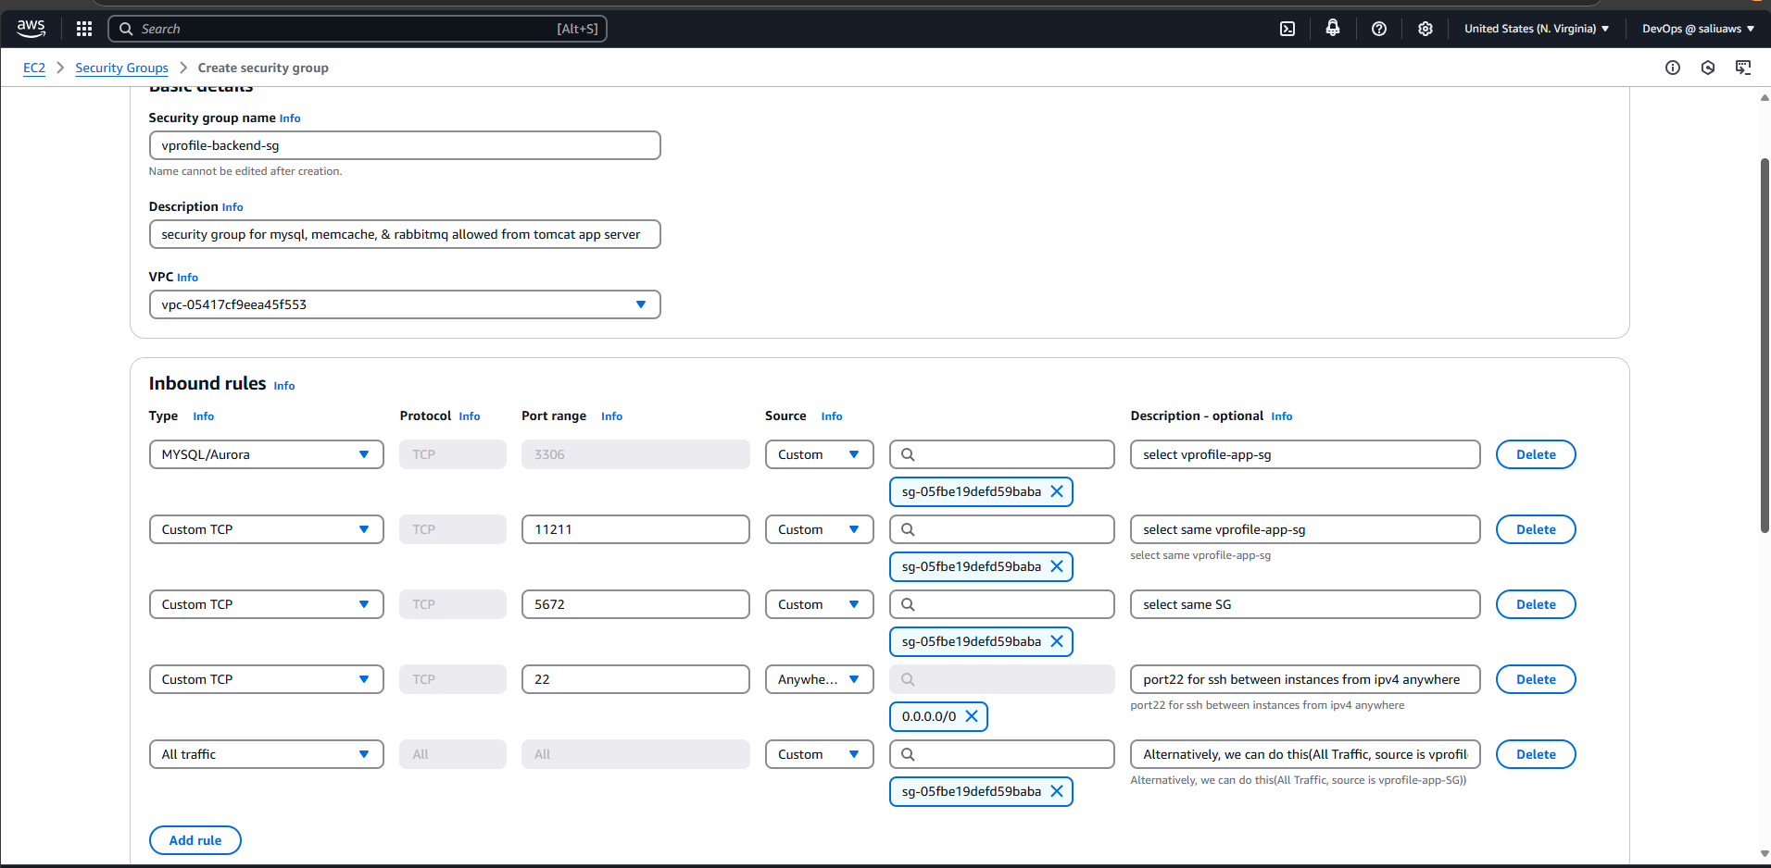
Security Group For The Backend
Edit inbound rules:
1. add Mysql/Aurora which is port 3306, source: select the vprofile-app security group (ie the Tomcat Instance SG)
2. add port 1121, source: select same tomcat SG
3. add port 5672, source: select same tomcat SG
4. add port 22 for ssh, source: select ipv4 from anywhere
Alternatively to all this listennings, we can simply do:
Select All Traffic, source: Tomcat SG alongside with number (4.) above.

Slide 12
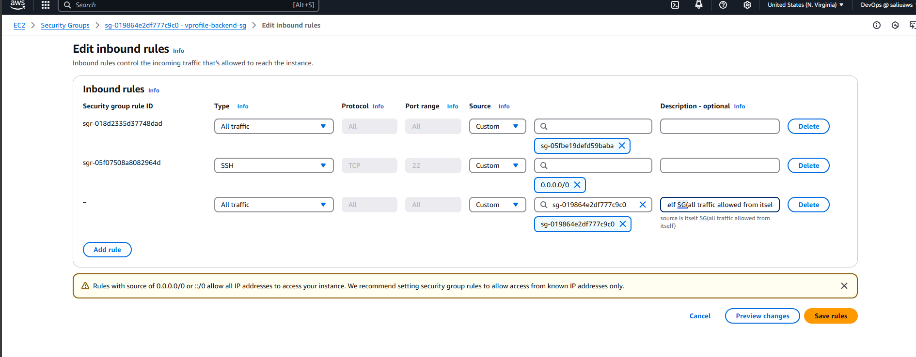
Alternatively to the Backend SG also add All traffic, Source: Select same backend SG so that all incstances can connect to themselves.

Slide 13
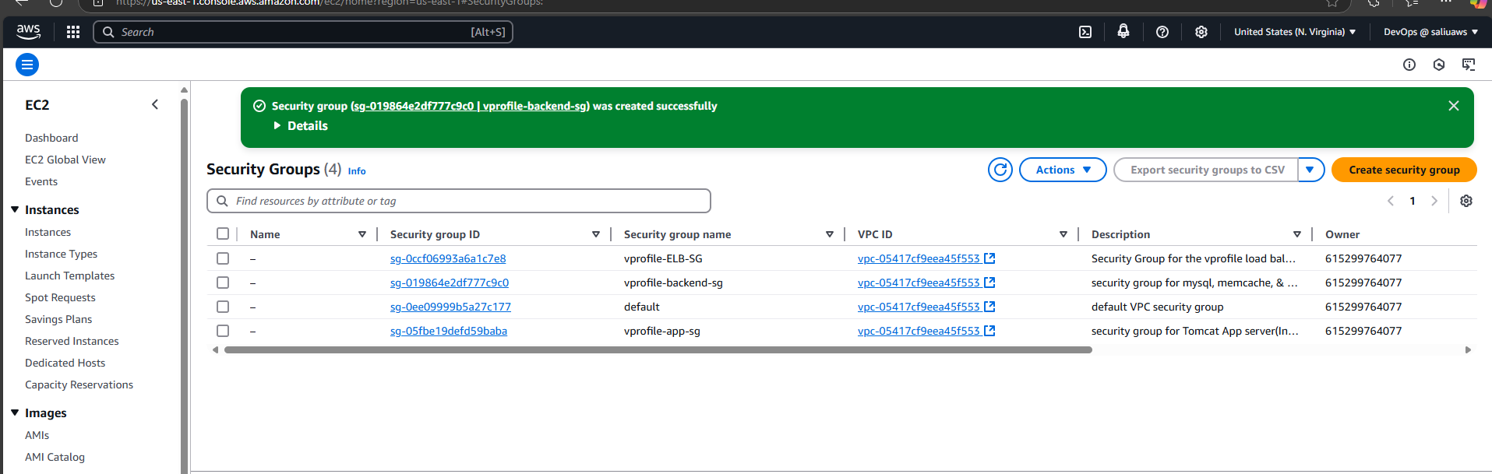
All Three Security Group Created

Slide 14
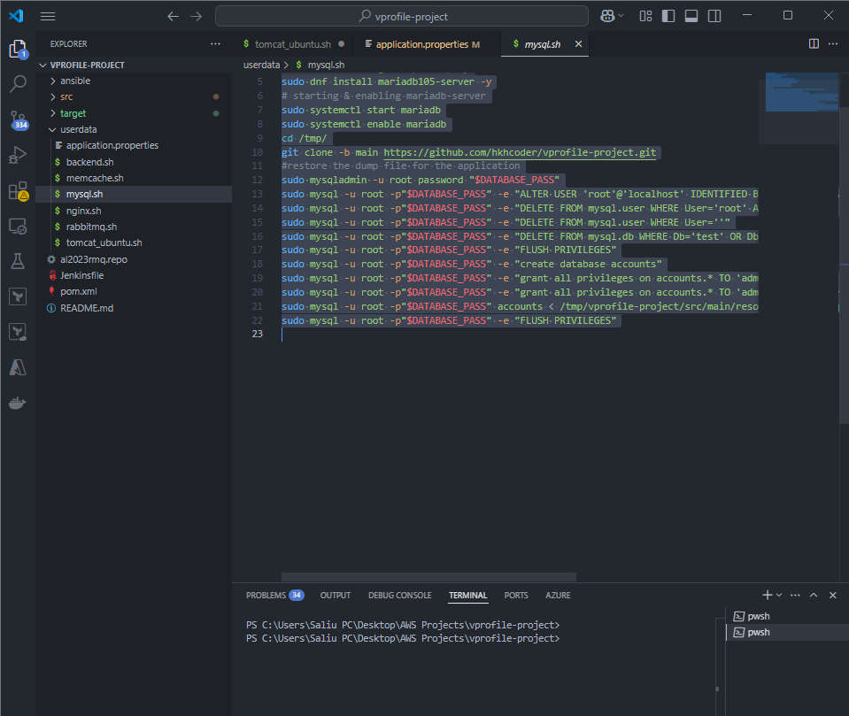
4. Launching Instances with User Data (Bash Scripts)
all the bash Script to be used on this Project are documented on the Project directory Userdata.
We are going to be launching 4 Instances:
Vprofile-db01(for database)
Vprofile-app01(for Tomcat)
Vprofile-mc01(for memcached)
Vprofile-rmq01(for rabbitmq)

Slide 15
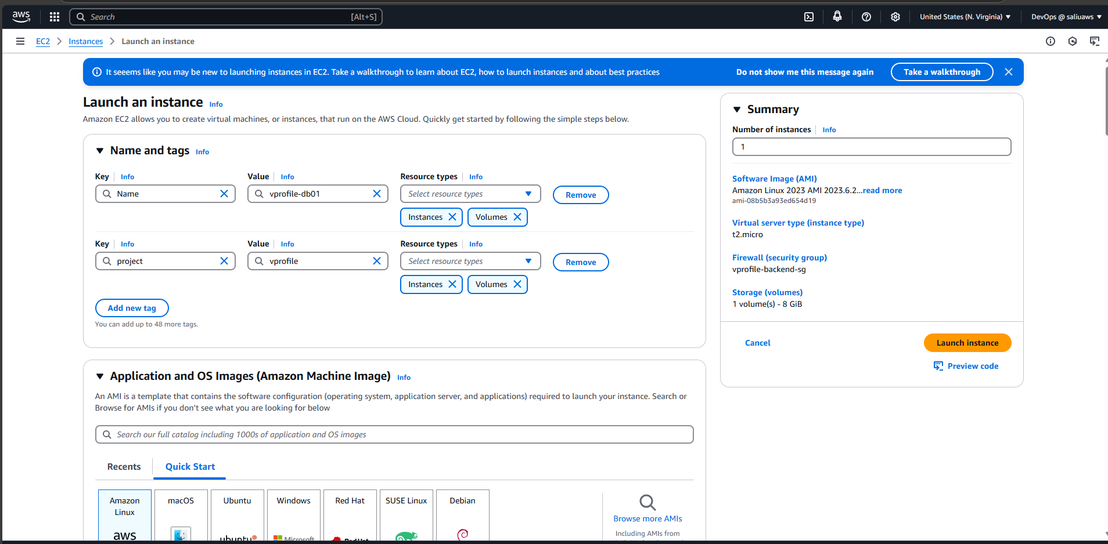
Launching ec2 Instance for Vprofile-db01(DataBase Instance)

Slide 16
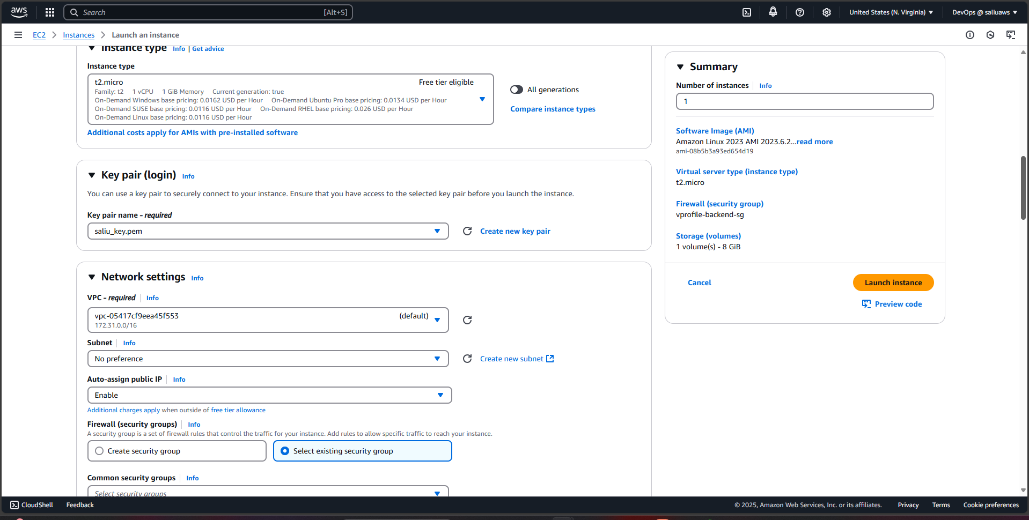
Vprofile-db01 continuation clicked on existing security group & select vprofile-backendSG

Slide 17
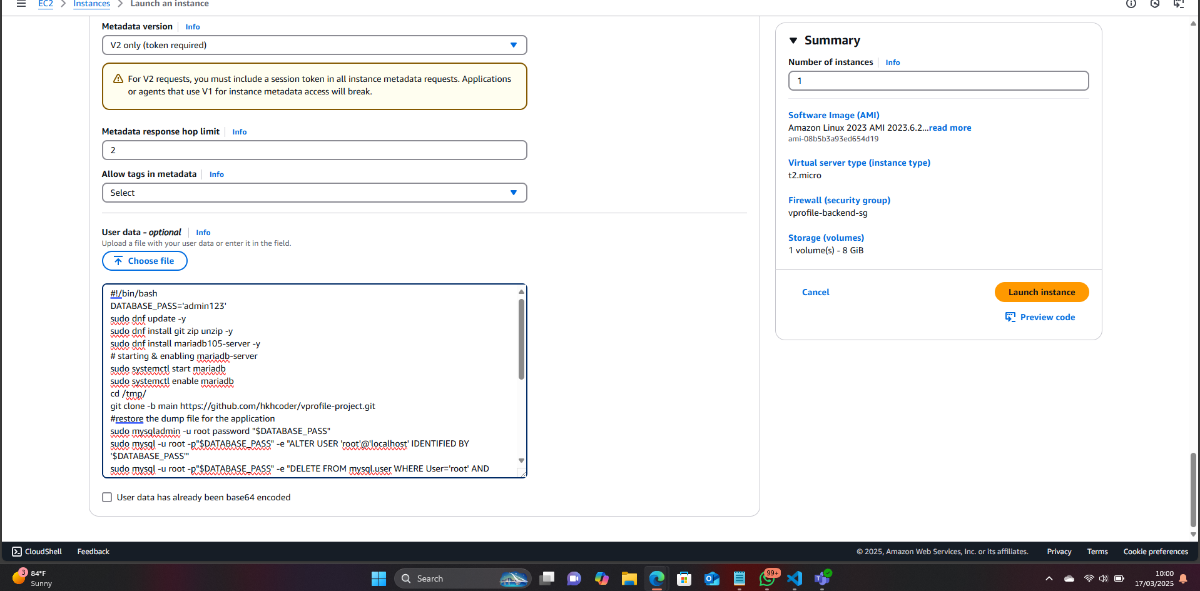
Vprofile-db01 continuation expand advance Details and paste Ur bash script copied from the source code. (Repeat same process for memcahed, & rabbitMQ Instances.)

Slide 18
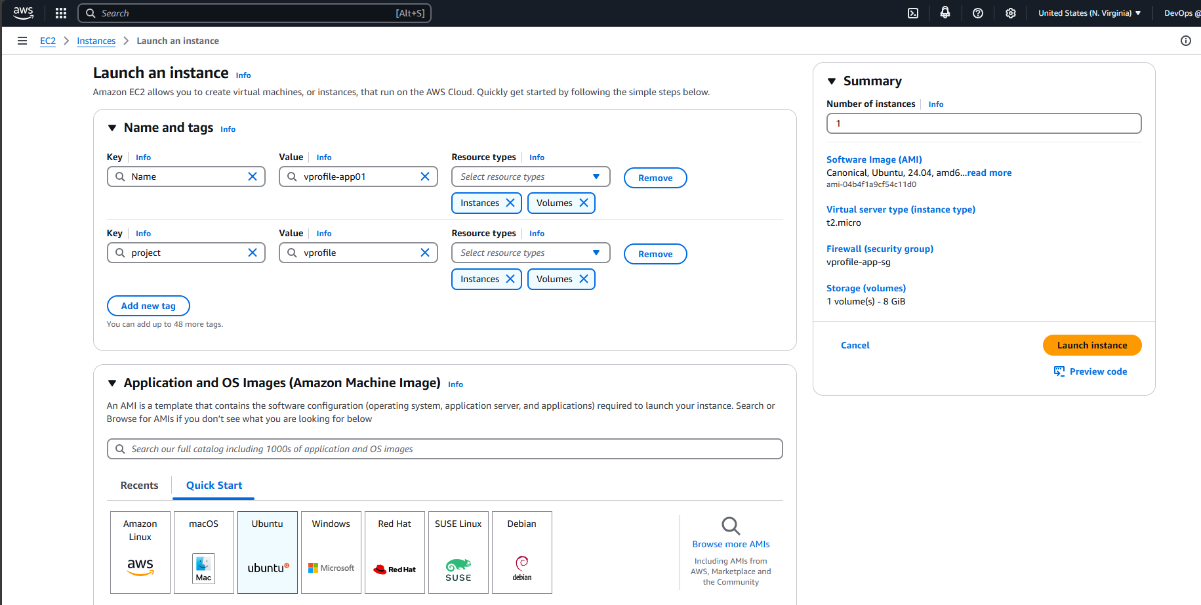
Launching ec2 Instance for Vprofile-app01(Tomcat Instance) here we used Ubuntu AMI

Slide 19
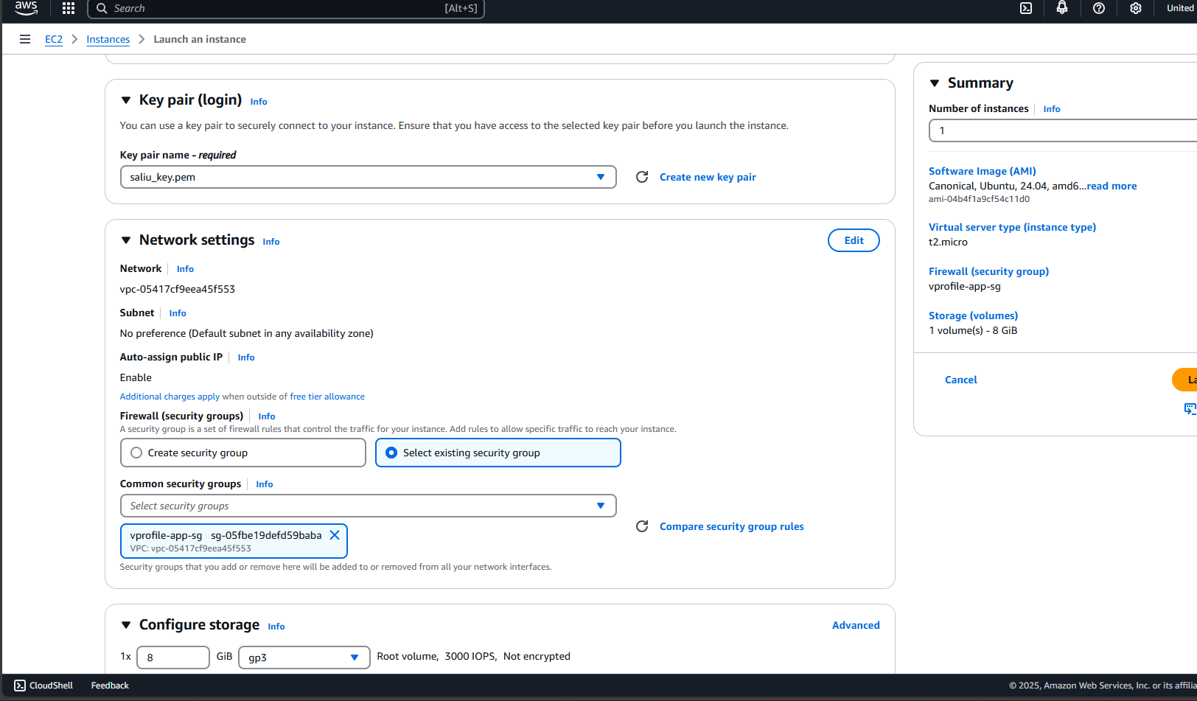
Vprofile-app01 continuation clicked on existing security group & select vprofile-app-SG

Slide 20
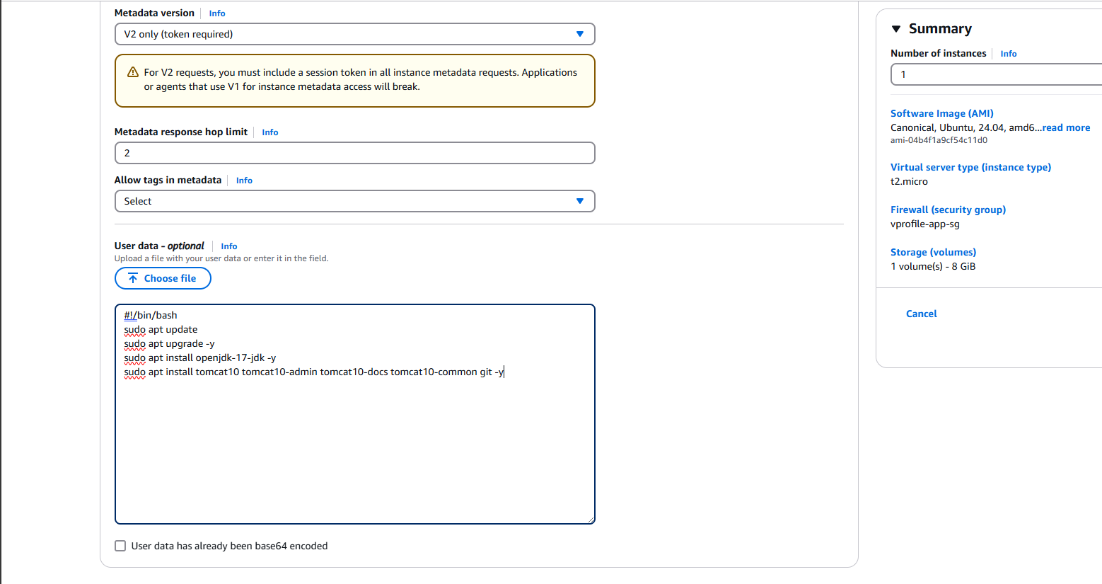
Vprofile-app01 continuation expand advance Details and paste Ur bash script copied from the source code.

Slide 21
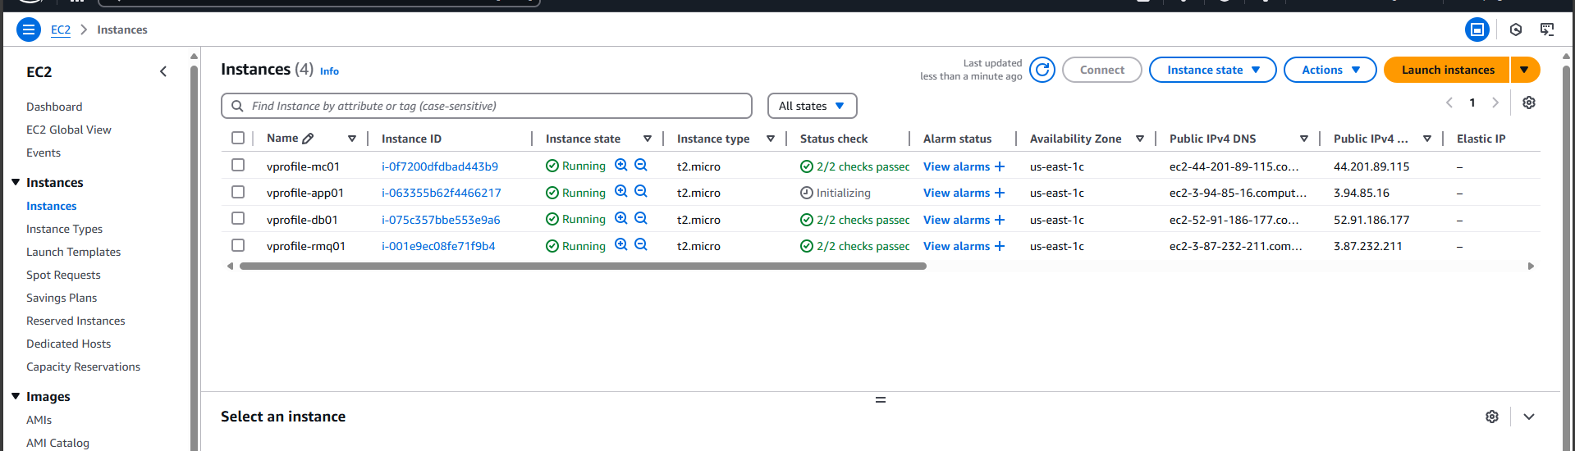
All Instances Up & Running

Slide 22
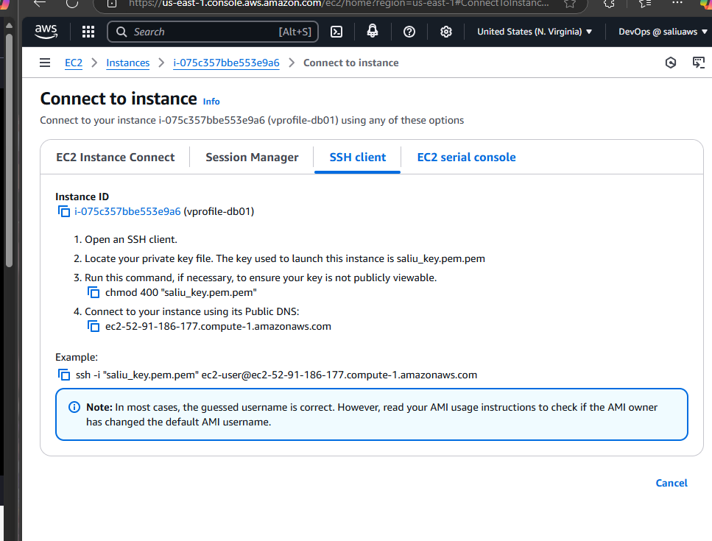

click on the check box of one of the above instances, go to 'connect to instance' go to the ssh client to copy the instance ssh-login details

Slide 23
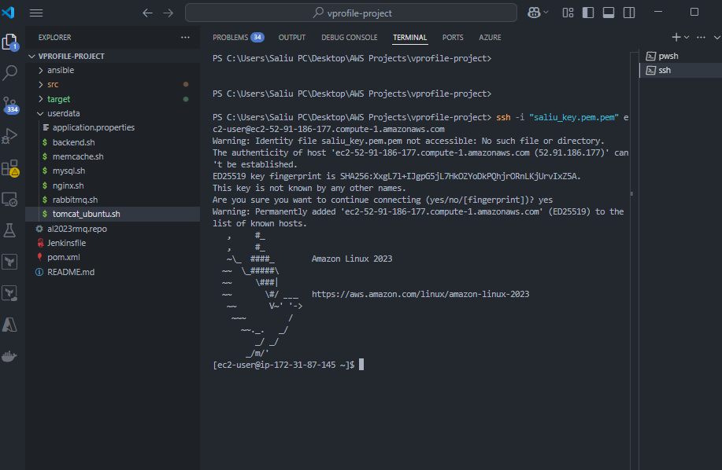
We ssh into every Instances to Confirm every scripts works perfectly: paste the instance copied ssh-login details on Ur terminal where Ur AWS SSH-private key is located and click enter. Repeat same process on other instances.

Slide 24
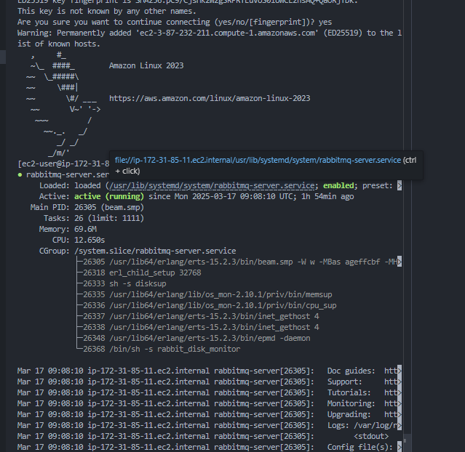
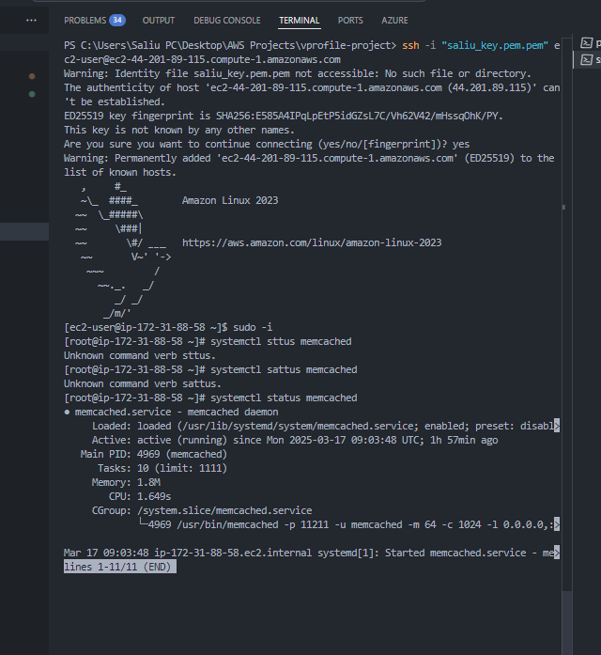
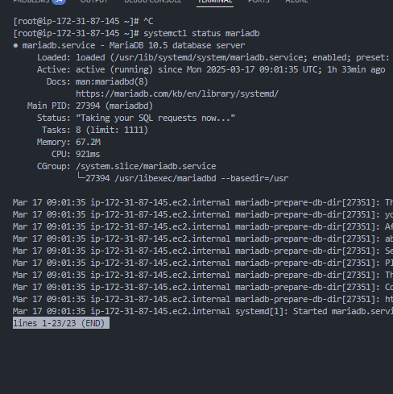

All Instances checked
All the Instances are working perfectly, all Bash scripts works perfectly.

Slide 25
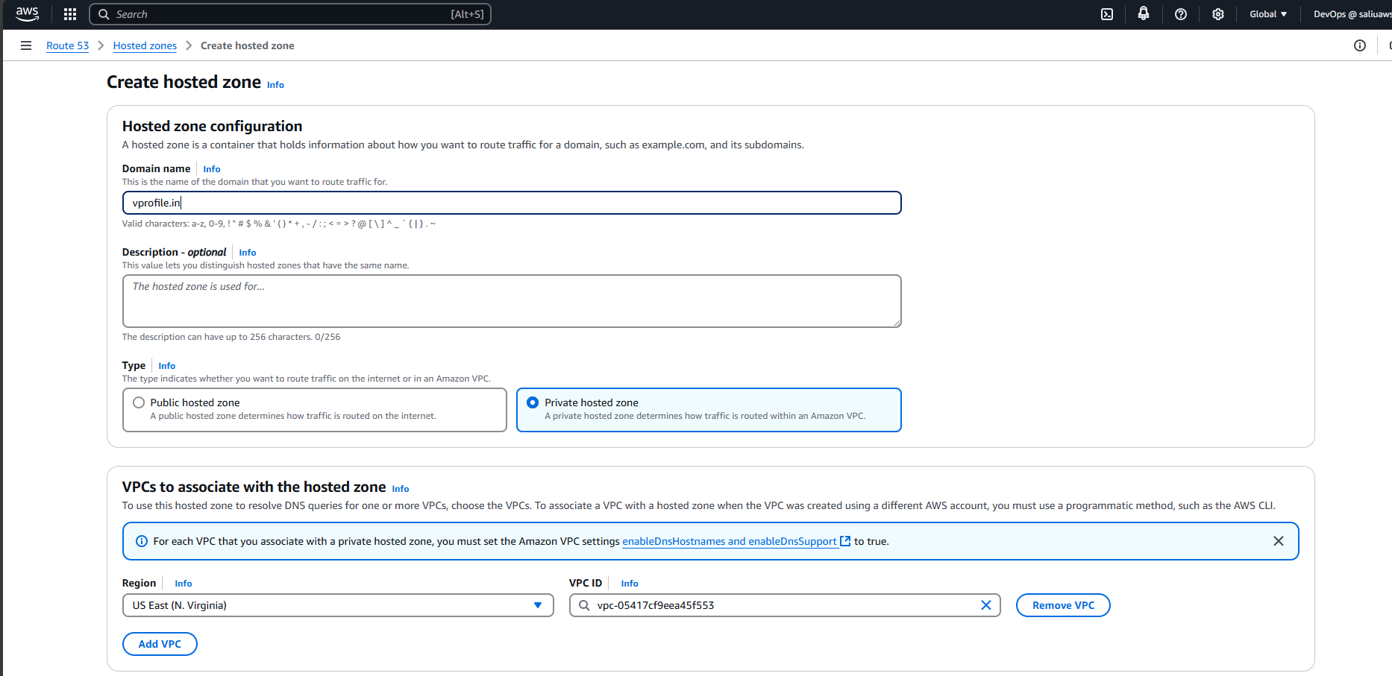
5. Updating Ip to name mapping using Route 53(AWS DNS) we go to route 53 & create a Hosted Zone

Slide 26
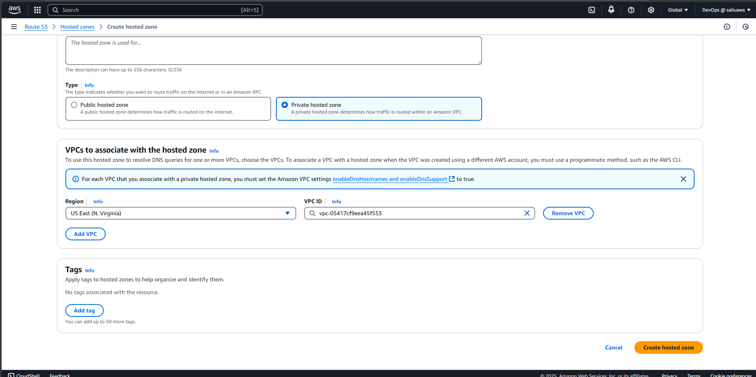
Continuation of name mapping using route53

Slide 27
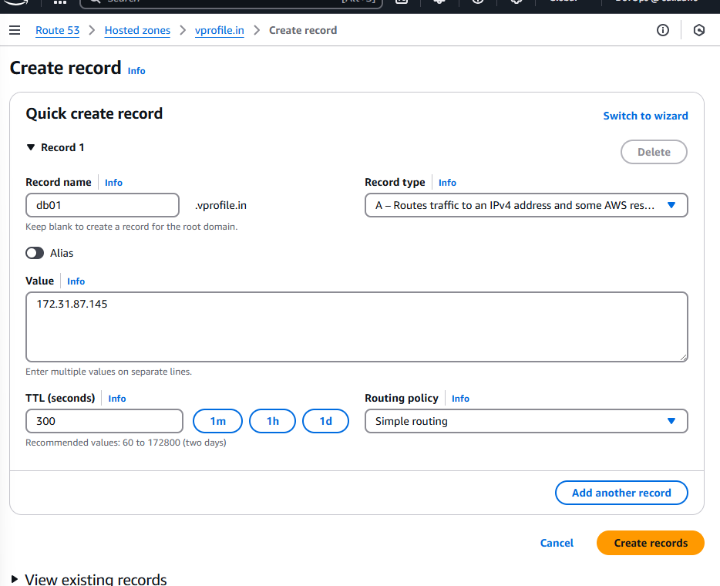
After Creating Hosted Zones, we create records to mapp all the instances private ips to name(ie mapping 172.31.87.145 to db01)

Slide 28
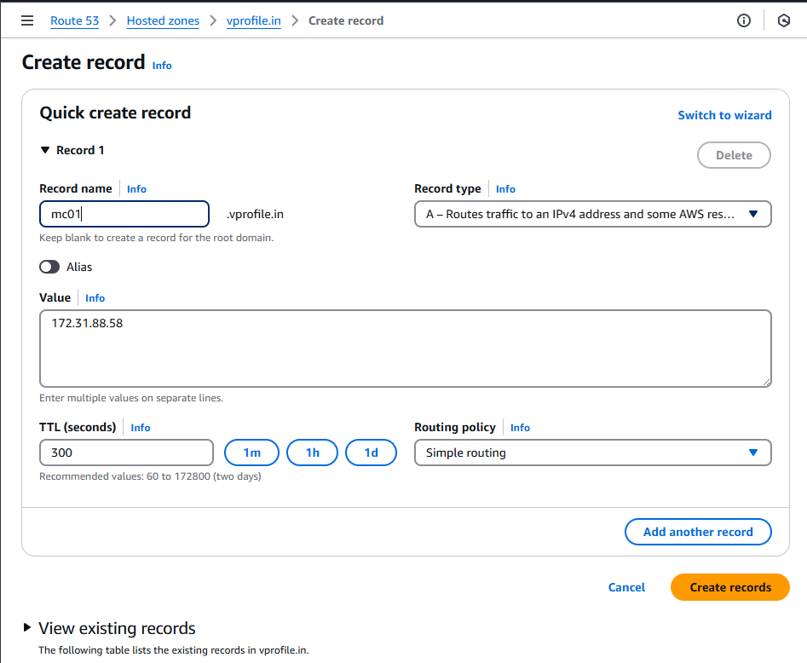
Private Ip to name mapping for(memchaced instance)

Slide 29
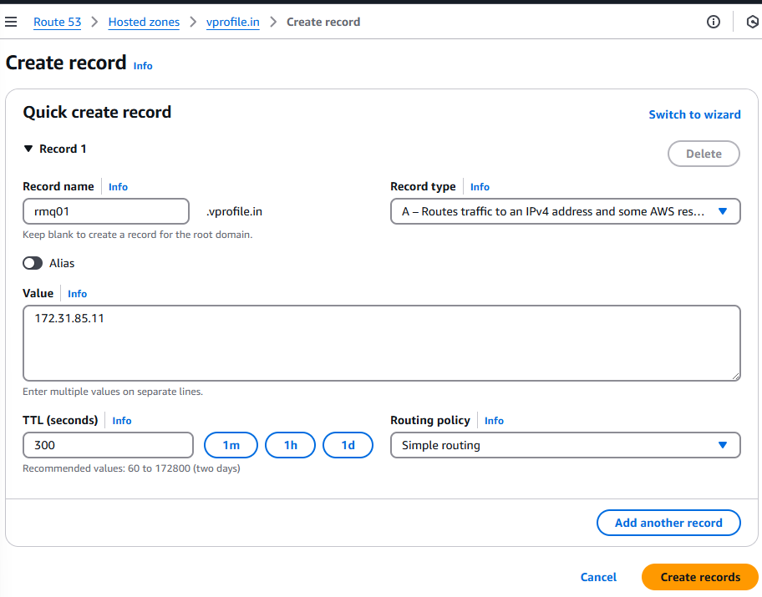
Private Ip to name mapping for(RabbitMQ instance)

Slide 30
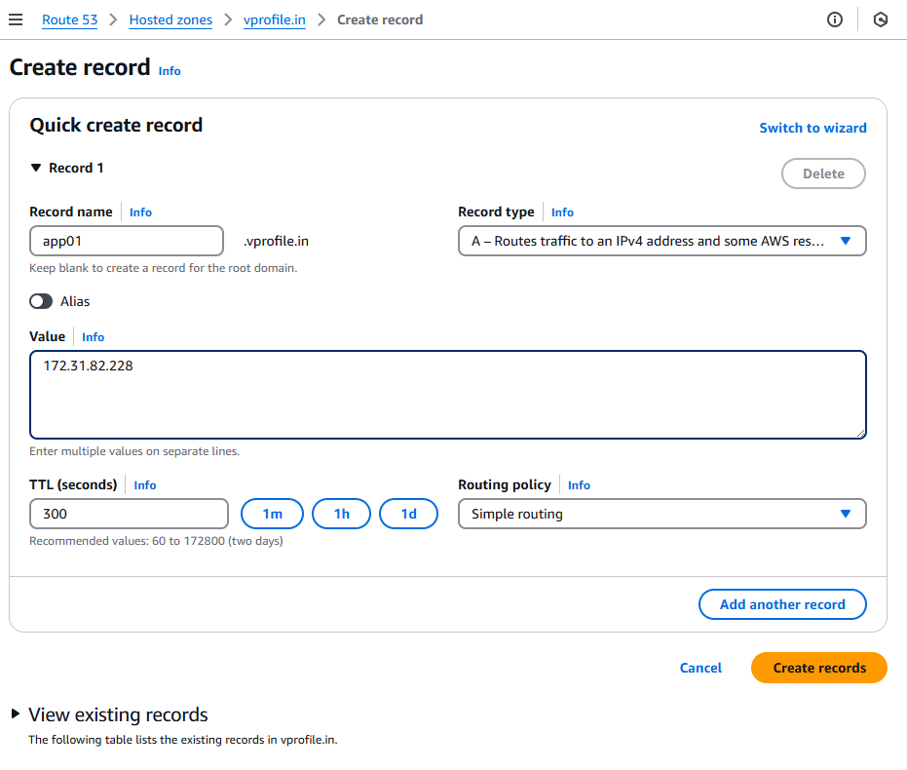
Private Ip to name mapping for(TomCat instance)

Slide 31
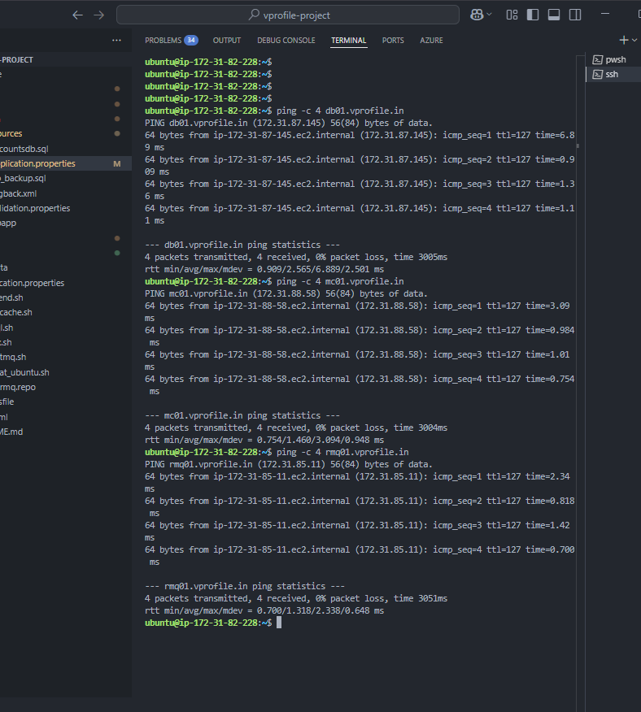
After Mapping is Completed, we ssh into the vprofile-app01(Tomcat Instance) to ping all other instances using their record names. And it was a success

Slide 32
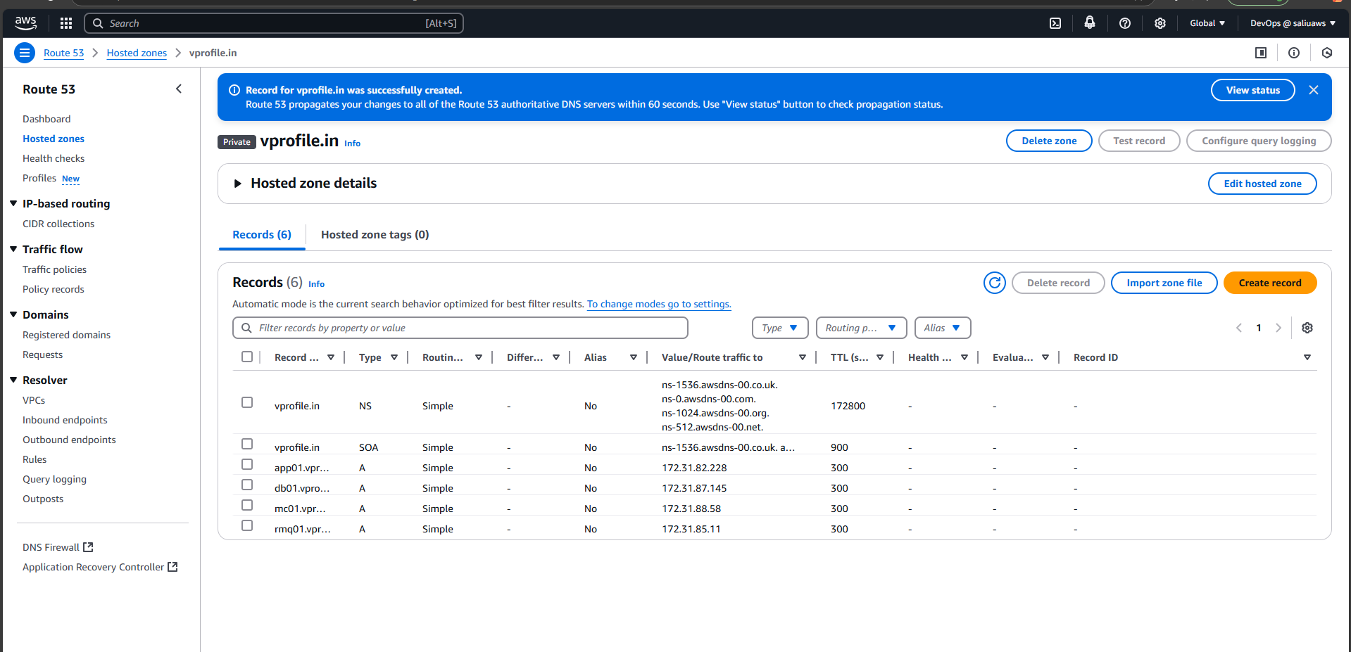
Route53 ip to name mapping completed. Creating Record for all the 4 instances.

Slide 33
6. Building The Application From The Source Code with Maven.
We are going to build the project Artifact from the source code, & Push it to an s3 bucket, after that on the Tomcat instance(vprofile-app01), we fetch the Artifact from the s3.
We are going to install maven, open jdk(Java), AWSCLI on our system to enable us build the source code, communicate with AWS and push the Artifacts to S3.

Slide 34
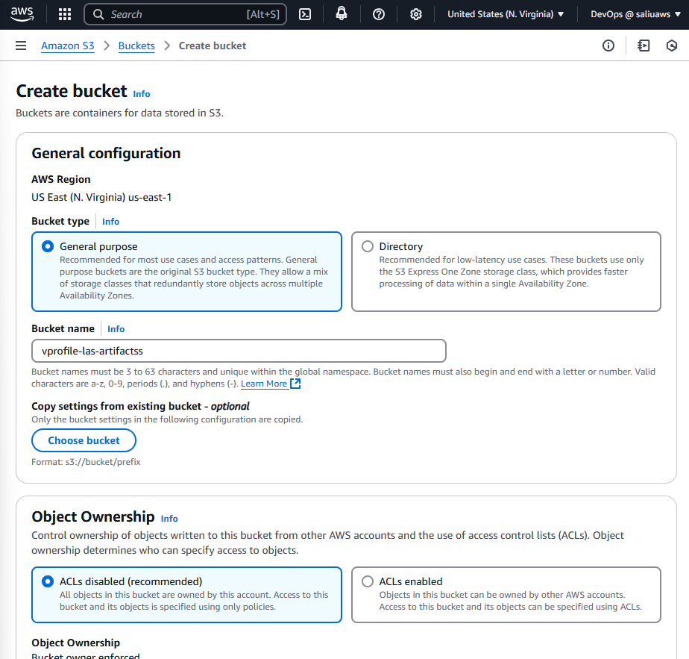
First we create an s3 bucket on AWS

Slide 35
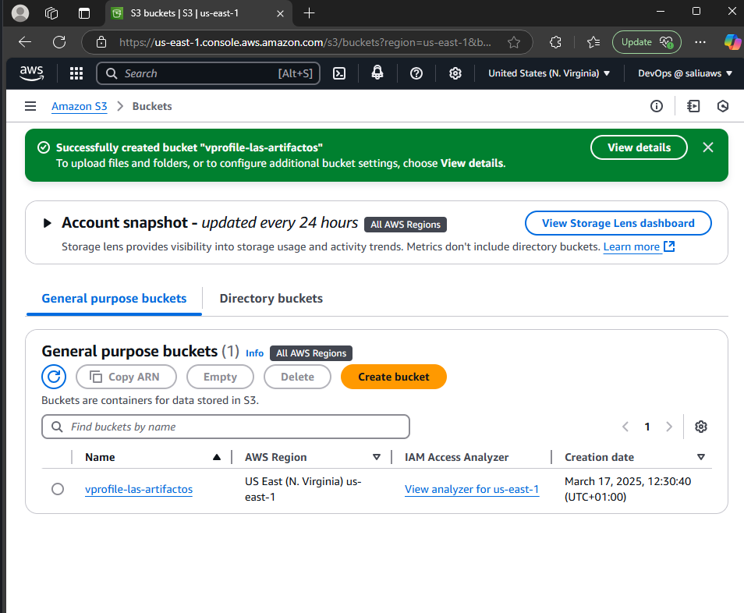
S3 bucket created for our artifacts

Slide 36
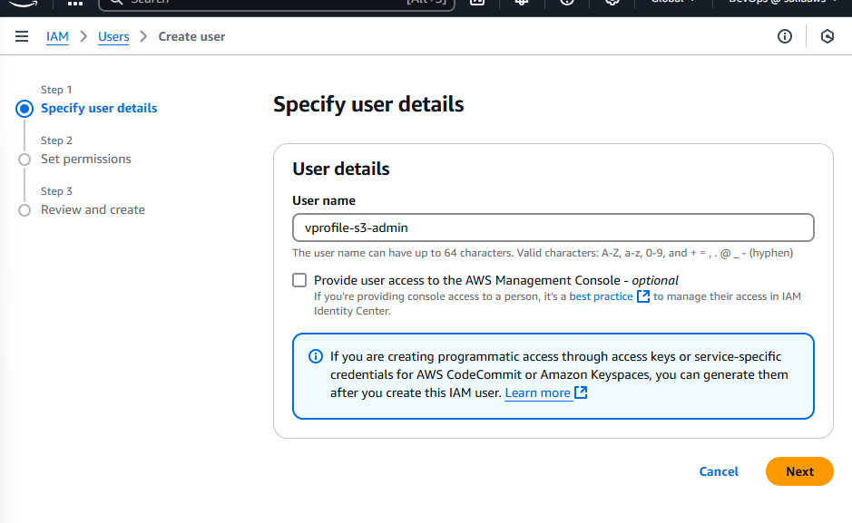
Second We create a user & assign IAM Roles

Slide 37
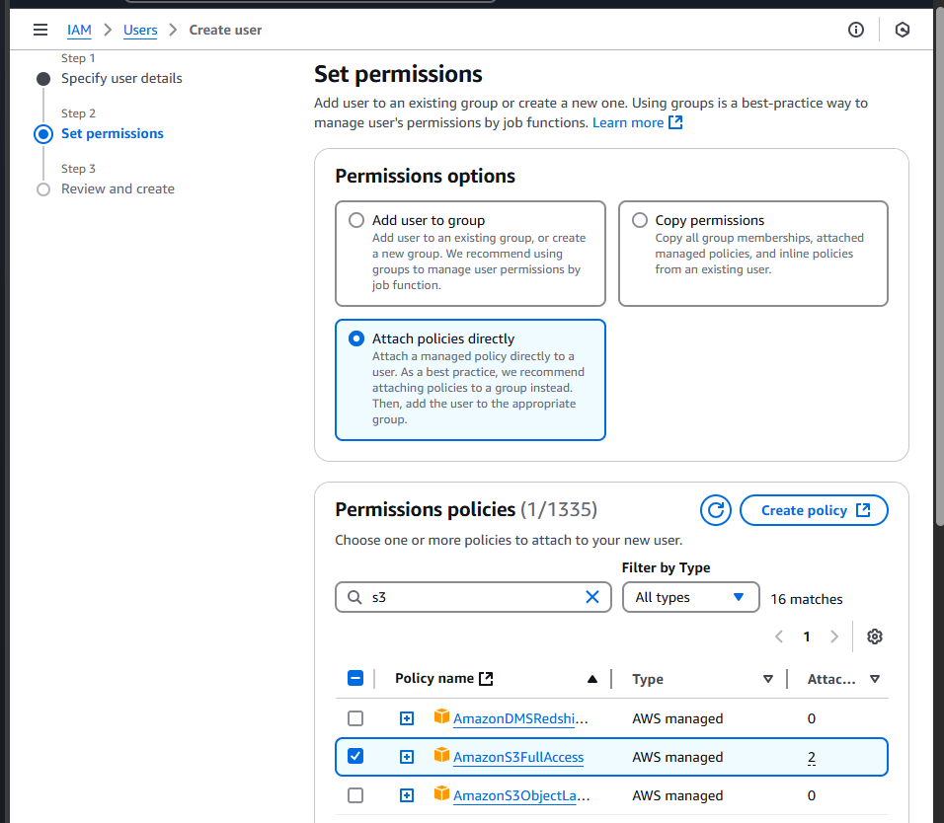
We Attached a IAM Policy to the User Created, granting s3 full access.

Slide 38
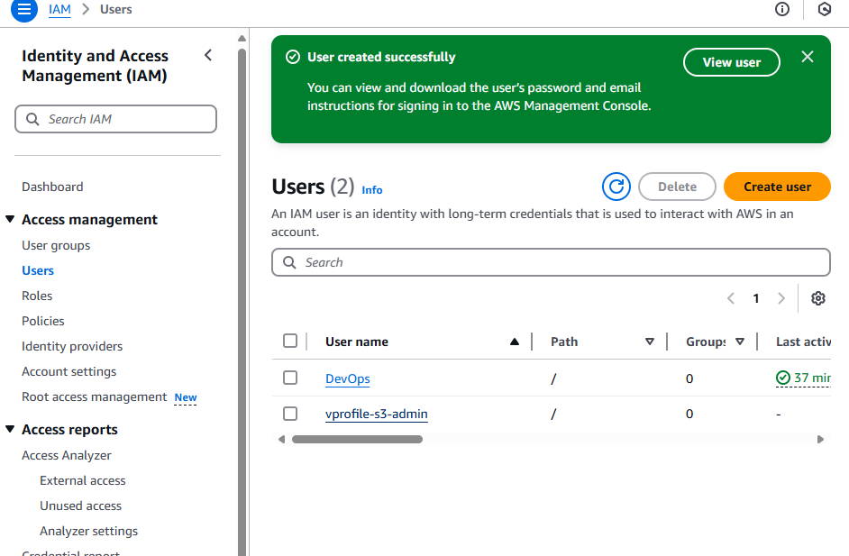
User with s3 full access Created successfully.

Slide 39
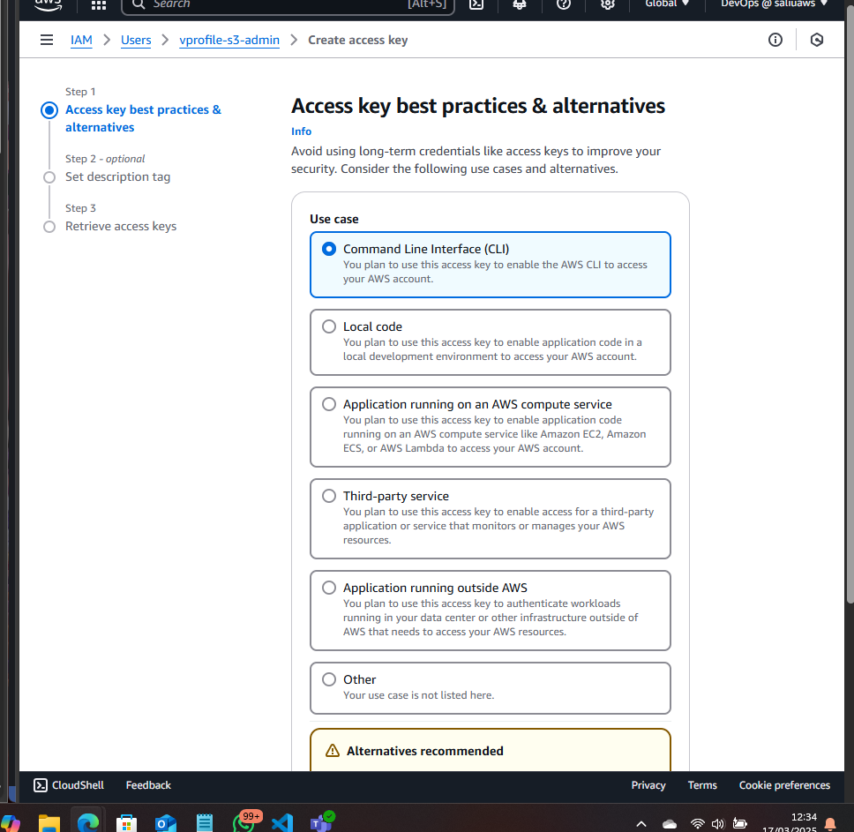
We Generated the User Access Keys

Slide 40
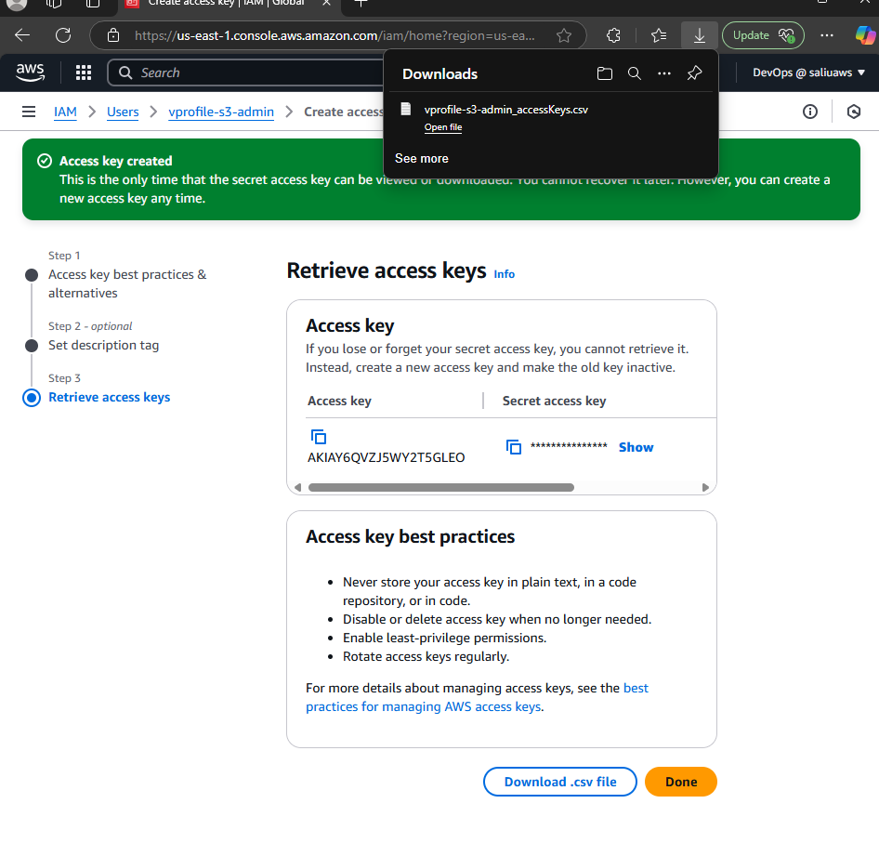
We downloaded the .CSV files containing the Access keys & Secret Access Keys.

Slide 41
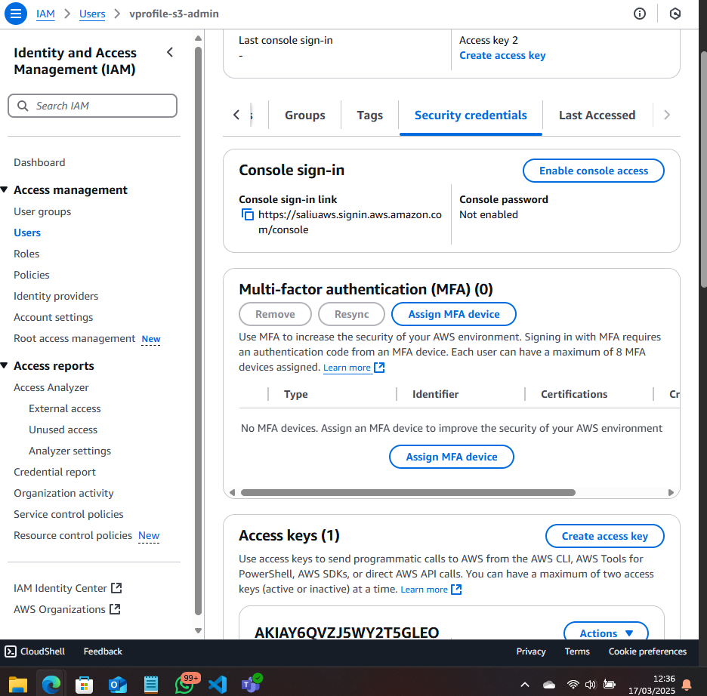
We Assign MFA(Multifactor Authentication) to the new User.

Slide 42
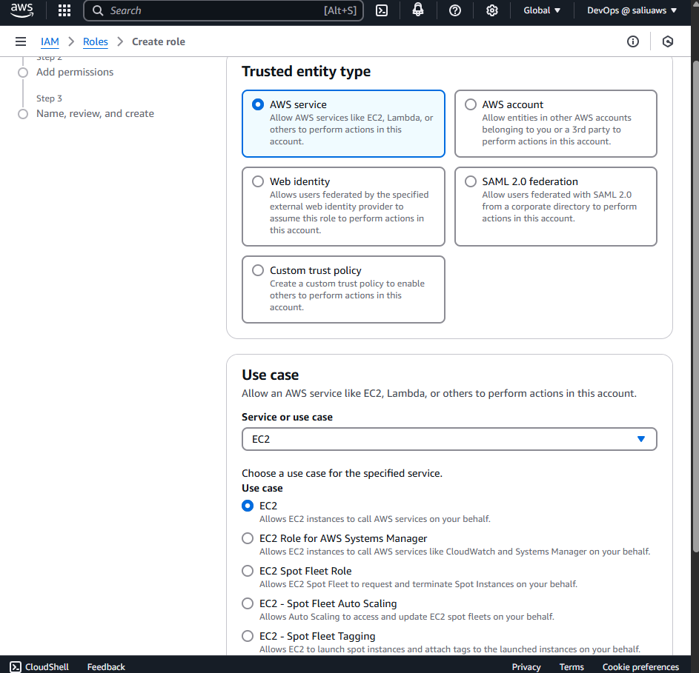
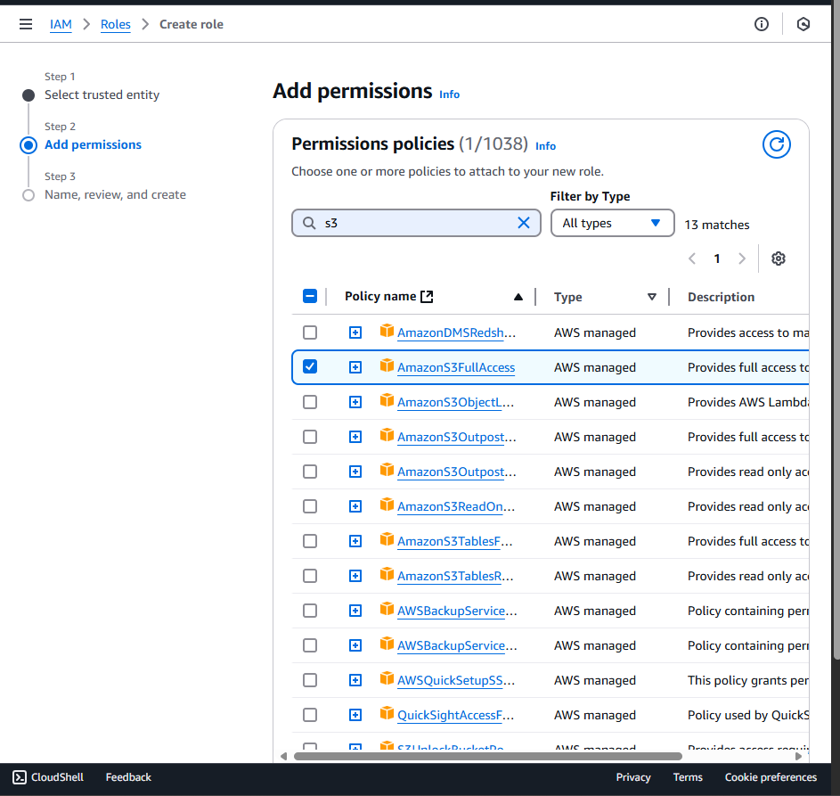
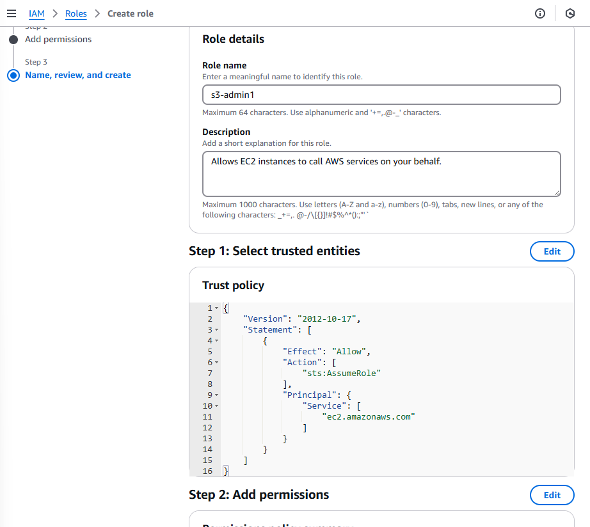
We create IAM Roles for Tomcat Instance(vprofile-app01)

Slide 43
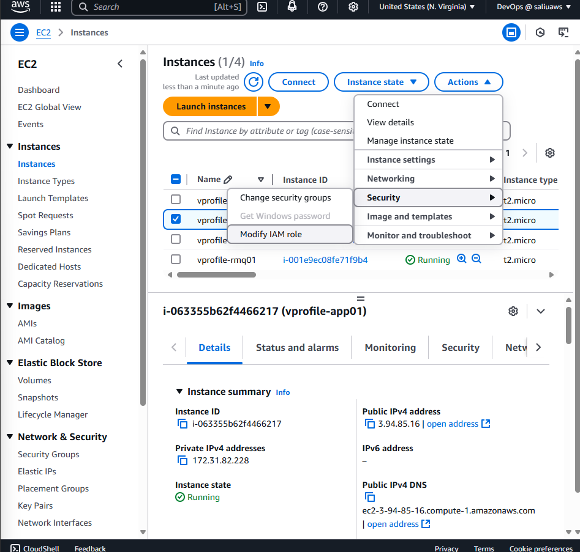
After Creating the Role, we assign it to Tomcat Instance
We go to our ec2 instances, select app01 instance & click on Actions
Scroll down to security, click on it & scroll down to 'Modify IAM Roles' and select the roles created from the dropdown.

Slide 44
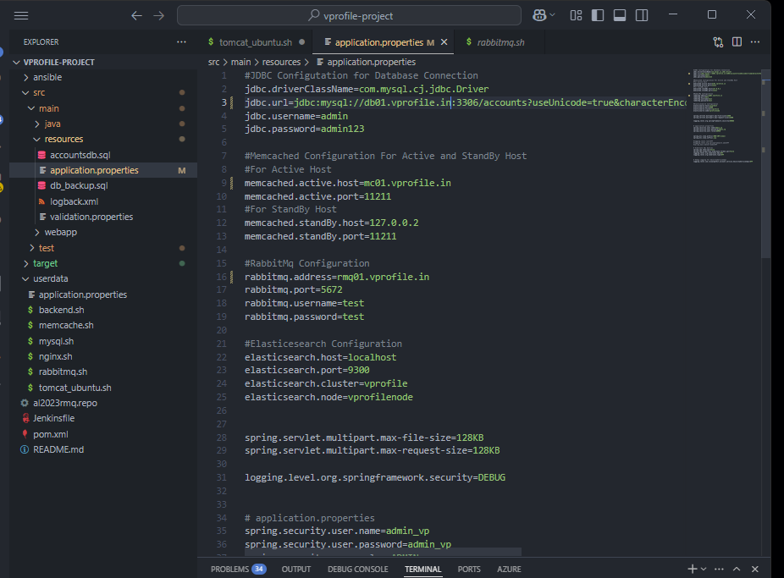
Now we go build our Source code on our computer & push our Artifact to s3 earlier created.
Before that we have to do this:
Go into the source code, main, the application.properties file to add '.vprofile.in' to all the instance names as earlier recorded on route53.

Slide 45
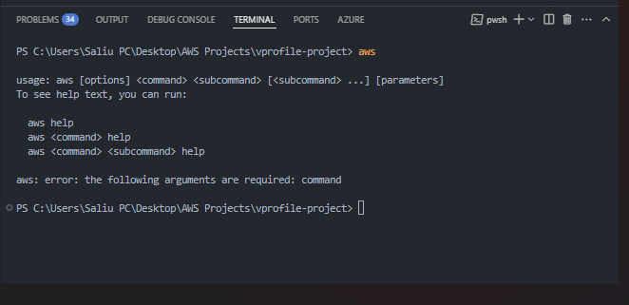
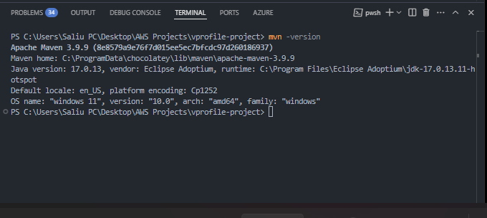
Installations of Maven, Java, and AWSCLI on my Computer

Slide 46
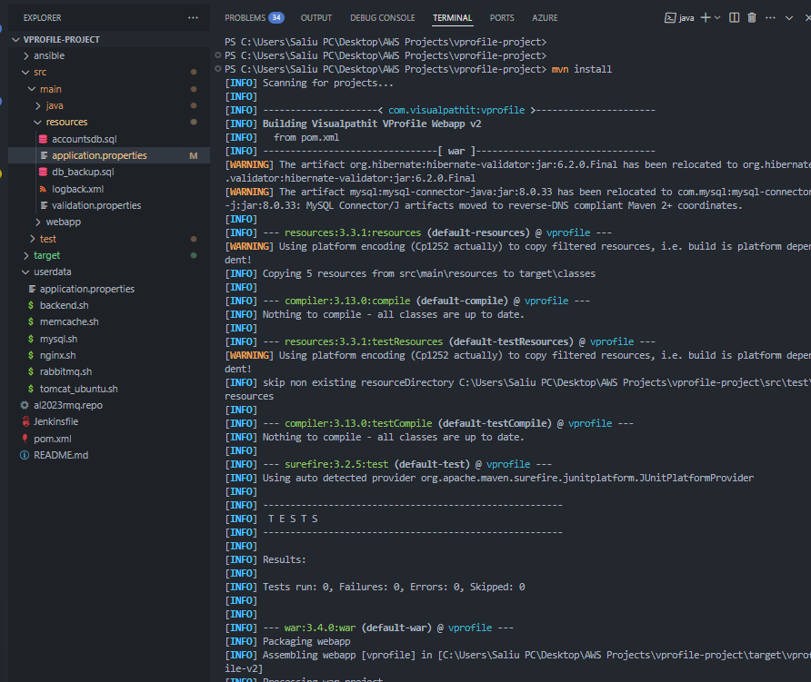
Project Build was a Success, A Target Directory Created to store Artifact

Slide 47
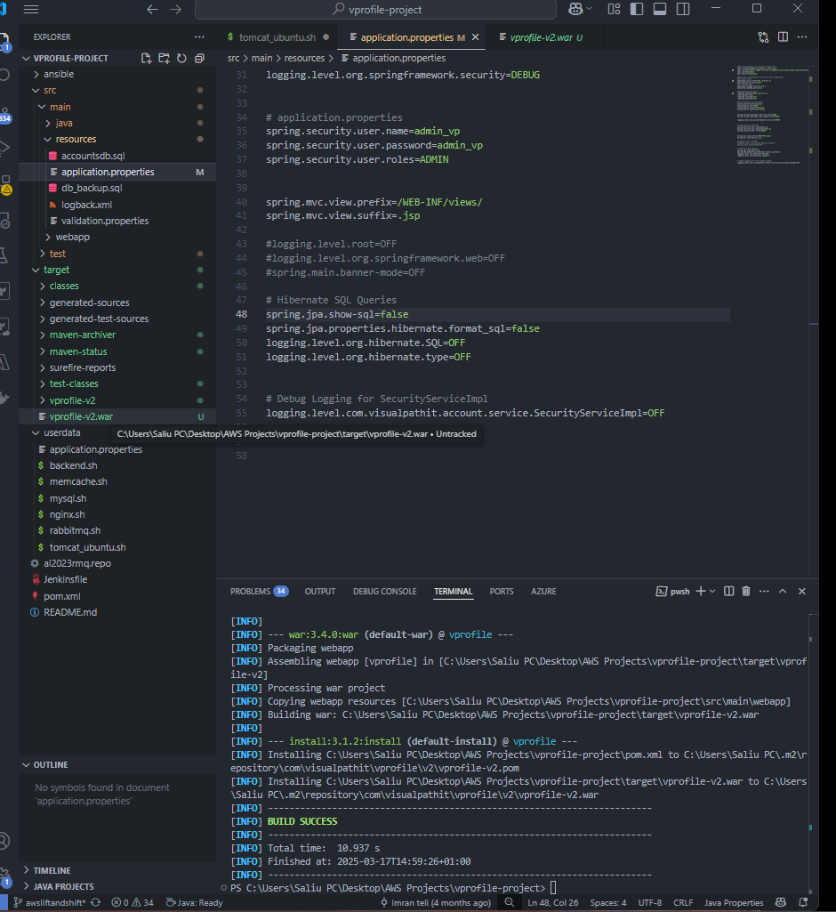
Build completed, & Inside the Target Dir we have our project Artifact(Vprofile-v2.war)

Slide 48
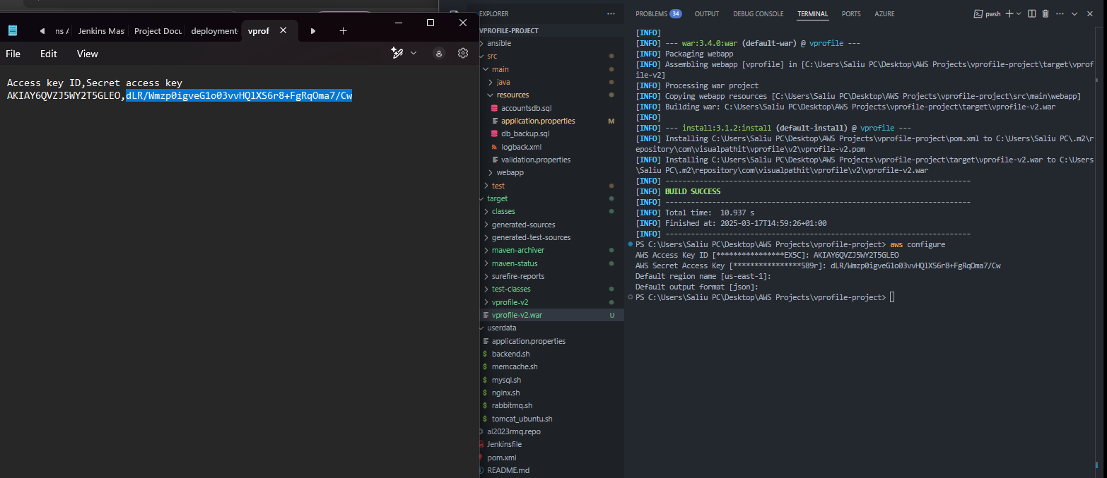
7. Uploading Artifact To S3 Bucket using the IAM User Cred created in (6.) we Loginto AWS via CLI using our system terminal.

Slide 49
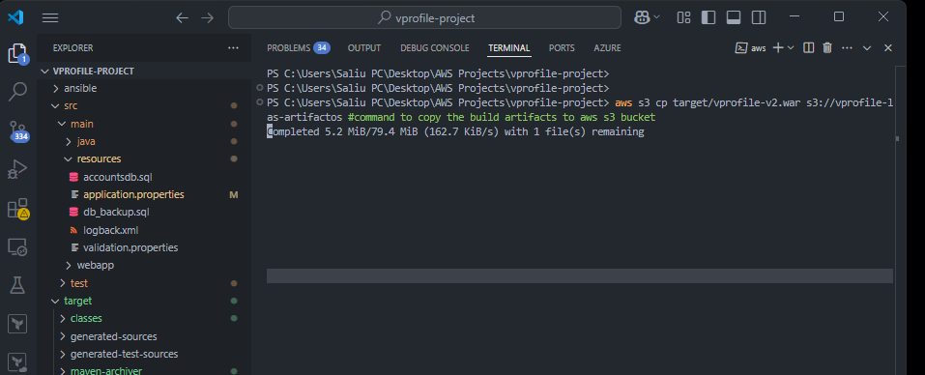
We Use the Below command to push Our Artifact to AWS S3 bucket we earlier Created in section6.

Slide 50

Artifact Successfully Uploaded to ASW S3

Slide 51

We still verify it using the Terminal

Slide 52

8. Downloading the Artifact from s3, to Our Vprofile-app01 Instance (Tomcat Instance) first we install AWSCLI on this instance so it can communicate with AWS

Slide 53
Command to download Artifact from S3 to our Tomcat ec2

Slide 54

Artifact successfully pulled from S3

Slide 55

We need to reconfigure Tomcat deamon so it recorgnised our Artifact

Slide 56

We configure Tomcat by: removing Tomcat webapps root files, & replacing it with Artifact(Vprofile-v2.war) & make tomcat to boot from it

Slide 57

Edit Tomcat Instance(vprofile-app01) inbound rule to allow port 8080 from any ipv4

Slide 58

Our Vprofile Project is live. Take the public ip of the Tomcat instance(vprofile-app01) put it on Ur browser along with the default port 8080 to have the first view of the project.

Slide 59

9. Setting Up Elastic Load Balancer(ELB) with HTTPS(Certificate from AWS ACM)
Creating ELB, 1st we created target Groups for Our Instance

Slide 60

Target Group Creation continuation

Slide 61


Still on Target group

Slide 62

Final page of the Target group creation for the vprofile-app01

Slide 63

Now We Create ELB for the Vprofile-app01(Tomcat instance)

Slide 64

Continuation on the ELB

Slide 65

Continuation on the ELB

Slide 66

Continuation on the ELB

Slide 67

Continuation on the ELB

Slide 68

ELB Successfully Created for the Tomcat server

Slide 69

10. Mapping ELB to endpoint to website name in Godaddy DNS ie creating a Cname record for the ELB

Slide 70

We coppied the ELB DNS name

Slide 71

The Cname name record created for ELB on our Godaddy DNS, we give it a name & add the ELB 'DNS name'

Slide 72

ELB COnfigured and Active

Slide 73

Target Group Health Check Shows Ok

Slide 74

Visiting our webapp page using the ELB link

Slide 75

11. Varifying the page Using configured Godaddy DNS Urls(with Certificate configured) to open the webapp. This time, that notsecured tag dissappeared cause of https certificate available

Slide 76

12. Building Autoscalling Group for our Tomcat Instance(vprofile-app01)
1st we create an Image for our Tomcat instance(Vprofile-app01)
Click on the instance check box, go to Actions, scroll down to image&templates, clicked on create image.

Slide 77

Creating image for Our Tomcat Instance

Slide 78

Continue to the next page

Slide 79


AMI Created

Slide 80

We create a new Launch Templates for our Instance

Slide 81

Creating a Launch Template

Slide 82

Creating a Launch Template continue.

Slide 83

Creating a Launch Template continued.

Slide 84

Creating a Launch Template continued.

Slide 85

Creating a Launch Template continued.

Slide 86

Creating Autoscalling Using the Our Instance AMI

Slide 87

Launching the Earlier Created Templates on the AutoScalling

Slide 88

Still on Creating Autoscalling select all the AZs

Slide 89

Attached Ur existing Loadbalancer on the AutoSchalling.

Slide 90


Still on AutoScalling Configuration

Slide 91


Still Creating AutoSchalling

Slide 92


Still on Autoschalling

Slide 93


Still on Autoschalling

Slide 94


Still on Autoschalling

Slide 95

Edit Ur LB Target groups to turn on stickiness

Slide 96
The End
The Auto Scahlling Configured is to schale in or out Automatically based on the traffic visiting our webapp server. From the above configurations, we set our webapp instance scale in to minimum of one Instance, & Maximum of 5 instances depending on the traffic.
The ELB earlier Configured was for Traffic Distribution, High Availability & Fault Tolerance, Scalability with Auto Scaling, Secure HTTPS & SSL Termination, Session Persistence (Sticky Sessions), & for Routing & Path-Based Routing.

